Slide 1
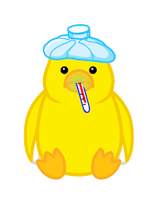
poultry diseases 1
fourth stage
شعار الكلية
chapter one – lecture 1
Introduction to Poultry Diseases & Relation to the Poultry Industry
Dr.Harith Abdulla
Department of Pathology and Poultry Disease
College of Veterinary Medicine University of Basrah
University of Basrah- College of veterinary medicine- Department of Pathology and Poultry Disease

Slide 2
Textbooks and Recommended References
David E. Swayne, John R. Glisson, Larry R. McDougald.Lisa K. Nolan, David L .Suarez,and
Venugopal Nar. Disease of Poultry, 13thEDITION. WILEY-BLACKWELL.
امراض الدواجن . الدكتور فؤاد الشٌخلي.ً
التشخٌص السرٌري المراض الدواجن:
د.احمد ماجد العطار و د. تحسٌن عبد العزٌز

Slide 3
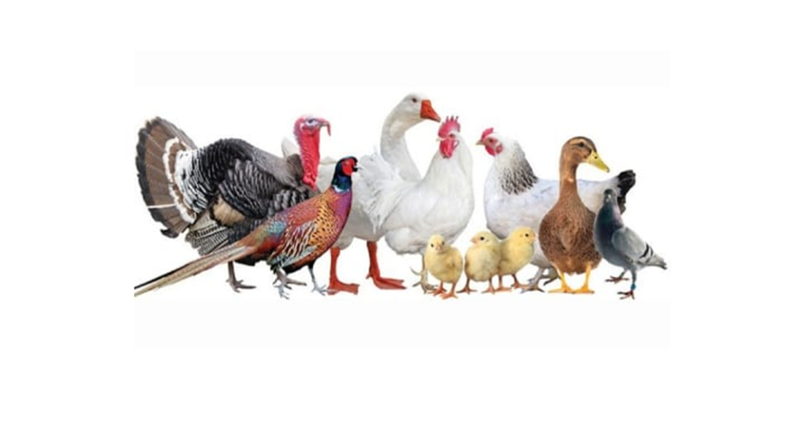
Define terms used in the poultry
Poultry is defined as economically important birds used either for food or show (includes chickens, turkeys, quail,ducks, geese, and guineas, and to some extent pheasants,
partridges and peafowl)

Slide 4
Poultry terms
1. Pullet — a young female chicken
2. Hen — a sexually mature female chicken (usually more than 10 months old) that has started to lay eggs
3. Chick — a baby chicken of either gender
4. Rooster — a sexually mature male chicken
5-Broiler a young male or female chicken,
6-layer is an older female chicken that is usually kept and raised specifically for egg production
7. Poult — a male or female baby turkey

Slide 5
Type depending on the environment and living conditions
synanthropic birds-an undomesticated birds(such as a pigeon, ) that lives in close association with people and benefits from their surroundings and activities. Such birds were synanthropes … that is, born wild but inherently predisposed toward associating themselves with humans.
Wild birds means all birds except domestic poultry
"domestic" describes any bird that has been bred within the country it resides in.

Slide 6
Poultry diseases: represent a significant challenge in the poultry industry, impacting the health, productivity, and economic viability of poultry farming. These diseases, which can be caused by viruses, bacteria, fungi, parasites, or nutritional imbalances, have the potential to spread quickly in flocks due to the close living conditions of poultry. Common diseases include Avian Influenza, Newcastle Disease, Infectious Laryngotracheitis, Salmonellosis, and Coccidiosis.

Slide 7
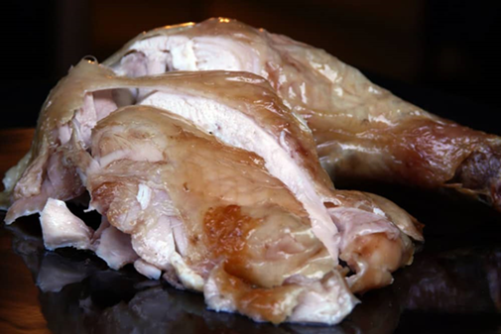
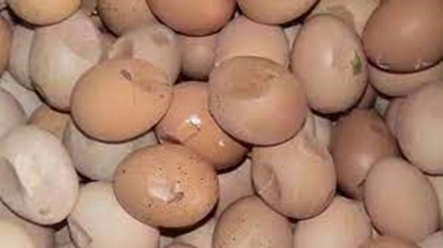
In the poultry industry, diseases can lead to reduced growth rates, lower egg production, reduced quality, increased mortality, and the need for costly treatments or preventive measures.

Slide 8
Furthermore, some diseases, such as Avian Influenza, can have zoonotic potential, posing a risk to human health and leading to severe trade restrictions.
In common terms, a disease is an abnormal condition that is caused by infection, basic weaknesses, or environmental stress.
A disease is defined by a specific group of signs or symptoms.

Slide 9
The poultry industry is a vital sector of agriculture focused on raising domesticated birds, primarily chickens, turkeys, ducks, and geese, for meat, eggs, and feathers. This industry plays a crucial role in global food production, providing affordable, high-protein food sources like chicken meat (broilers) and eggs.

Slide 10
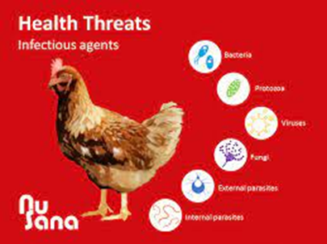
Infectious agents
Infectious diseases are caused by viruses, bacteria, and fungi. Parasitic diseases are caused by protozoa, worms, and external parasites such as mites and lice.

Slide 11
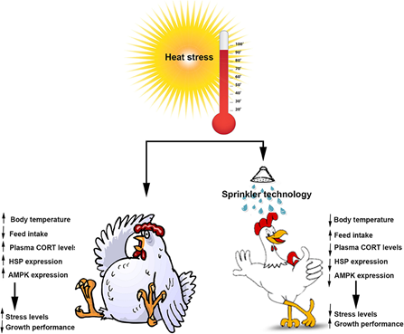
Environmental stress
Temperature stress – Heat and cold
Environmental stress – Air, light and litter
Physiological stress – Production and reproduction
Social stress – Housing
Physical stress – Handling

Slide 12
Poultry Diseases
1-Metabolic and Nutrional Deficiency Diseases.
2-Bacterial and Mycoplasmal Diseases.
3-Fungal Diseases.
4-Parasitic Diseases.
A-Protozoal Diseases.
B-Endoparasite (Internal).
C-Ectoparasite( External).
6-Viral Diseases.

Slide 13
Nutritional Deficiency Diseases
Nutritional deficiency diseases, also known as malnutrition or under nutrition, occur when an individual's diet lacks essential nutrients or when their body is unable to absorb and utilize these nutrients properly. These conditions can have serious health consequences and may lead to a range of specific diseases and disorders.

Slide 14
Vitamins
The amounts of various vitamins needed in poultry diets are very low. The vitamins function as cofactors for enzymes, hormones (e.g., vitamins A, D), or antioxidants (previtamin A and vitamin E).
The fat-soluble vitamins A, D, and E are stored relatively well and birds can withstand long periods of depletion before deficiency symptoms manifest. Water-soluble vitamins are not stored to a large extent, excesses are excreted mostly in urine, and they are relatively nontoxic.

Slide 15
Vitamin A
Is required for the health of the membranes of the digestive, urinary, reproductive and respiratory systems.
A vitamin A deficiency can result when the level in the diet is inadequate or the vitamin added to the diet is oxidized by rancid fat in the diet. Additionally, neomycin, a common antibiotic, decreases the absorption of vitamin A..

Slide 16
Vitamin A Deficiency
Vitamin A deficiency in the embryo results in a grossly abnormal cardiovascular system, characterized by an absence of vascular networks.
In chickens and turkeys (insufficient vitamin A during 1-7 weeks of age).
As in the case of other nutritional deficiencies, classic signs of deficiency are very rare in commercial poultry fed complete diets.

Slide 17
Functions of vitamin A :
Vitamin A is essential in poultry rations for:
a- Growth.
b-Optimum vision.
c-Maintaining the integrity of the mucous
membrane.
General Signs
1-Poor growth. 2-Poor feathering. 3-Drowsiness. 4.Off food. 5-Pale comb and wattles. 6-Rough feathers.

Slide 18
Special Signs of Vitamin A Deficiency:
1-Watery nasal and ocular discharge.
2-Eyelids stuck together with thick milky exudates.
3-Decrease egg production.
4-Increase embryonic mortality.
5-Ataxia.
6-Xerophthalmia.
7-Caseous material under the eyelids.

Slide 19
Post_mortem lesions:
Because epithelial linings of alimentary, urinary, genital, and respiratory systems are composed of mucous membranes, these are the tissues in which lesions of vitamin A deficiency are most readily observed as:
1-Eyelids inflamed and adhered.
2-Excessive urates in kidneys and ureters.
3-Pustules in mouth and pharynx.
4-Enlarged gall bladder.
5-Small ulcers at the site of the lesions.

Slide 20
Histopathology :
1-Atrophy of cytoplasm and loss of cilia in the
columnar ciliated epithelium of the respiratory tract .
2-Respiratory epithelium transformed into
stratified squamous keratinized epithelium.
Diagnosis:
1- Feed formulation.
2-Signs.
3-Lesions.
4-Histopathology.

Slide 21
Differential diagnosis:
1-Infectious coryza.
2-Chronic fowl cholera.
3-Infectious sinusitis.
4-Avian pox.
5-Trichomoniasis.
6-Thrush.
Prevention: Supplementation of diet with vitamin A.
Treatment:
vitamin A in drinking water

